Slide 1
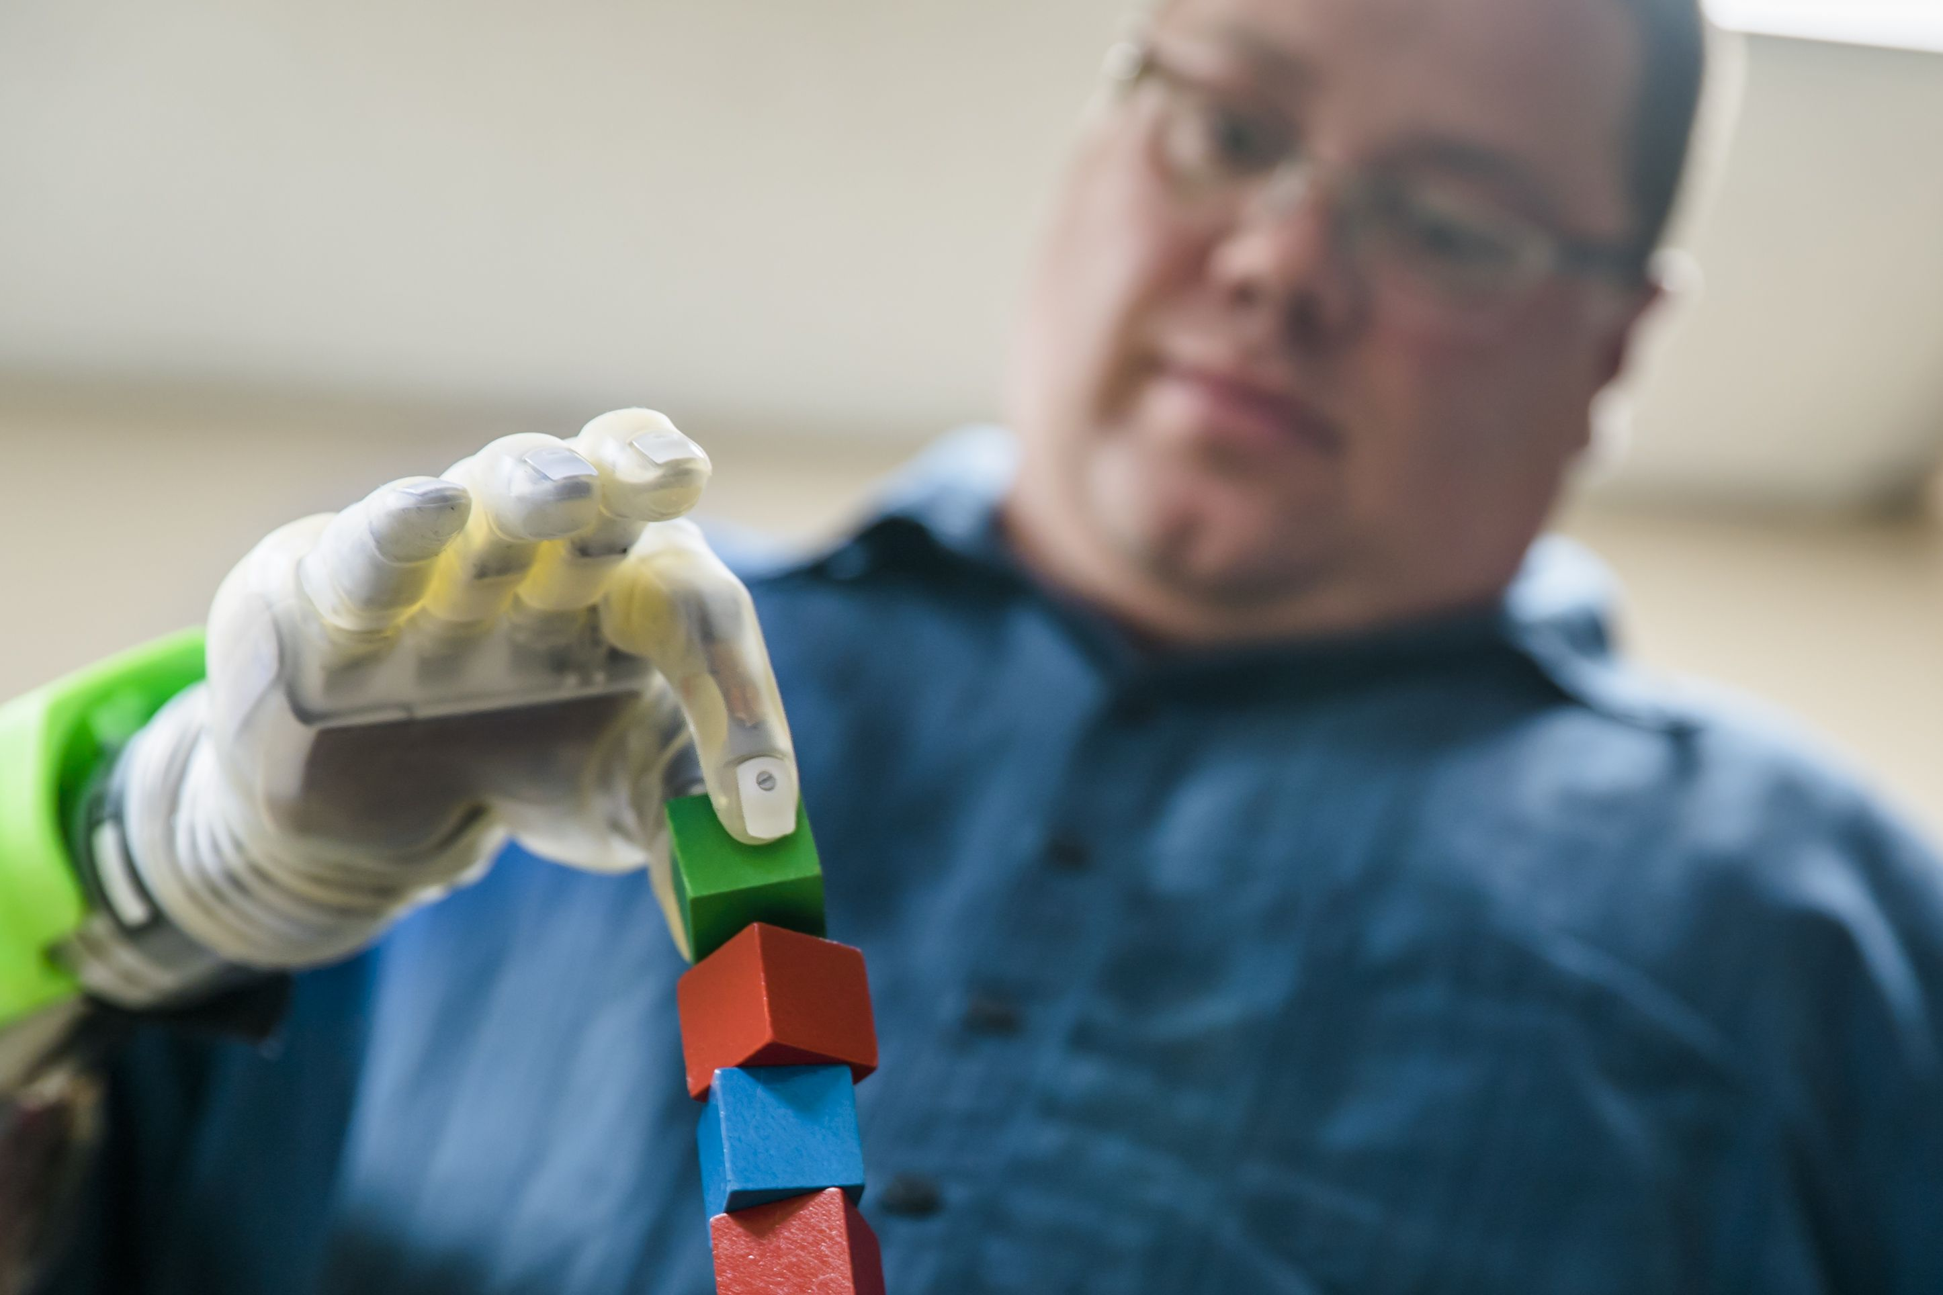
Introduction to Mind-Controlled Prosthetic Hands
- Mind-controlled prosthetic hands are revolutionary devices that allow amputees to control artificial limbs using their thoughts. These prosthetics utilize brain-computer interfaces (BCIs) to translate brain signals into commands for the prosthetic hand.

Slide 2
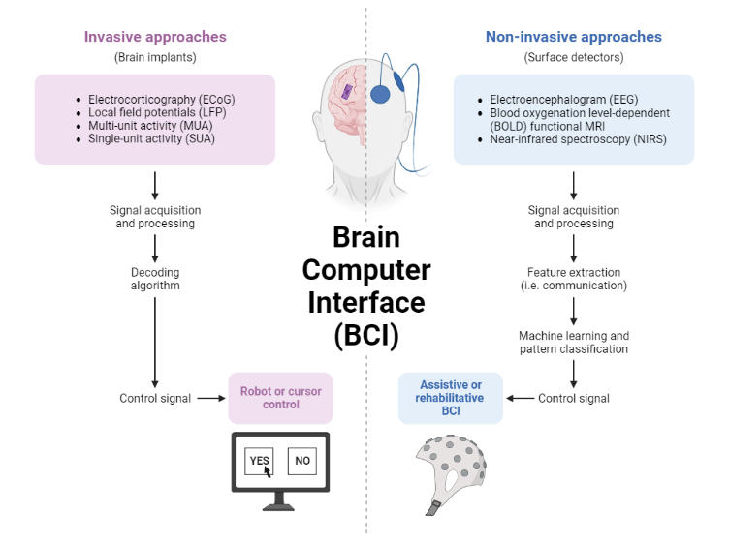
Brain-Computer Interface (BCI)
- BCIs are the bridge between the brain and the prosthetic hand. They read brain signals and convert them into commands that the prosthetic understands. There are two main types of BCIs: non-invasive and invasive.

Slide 3
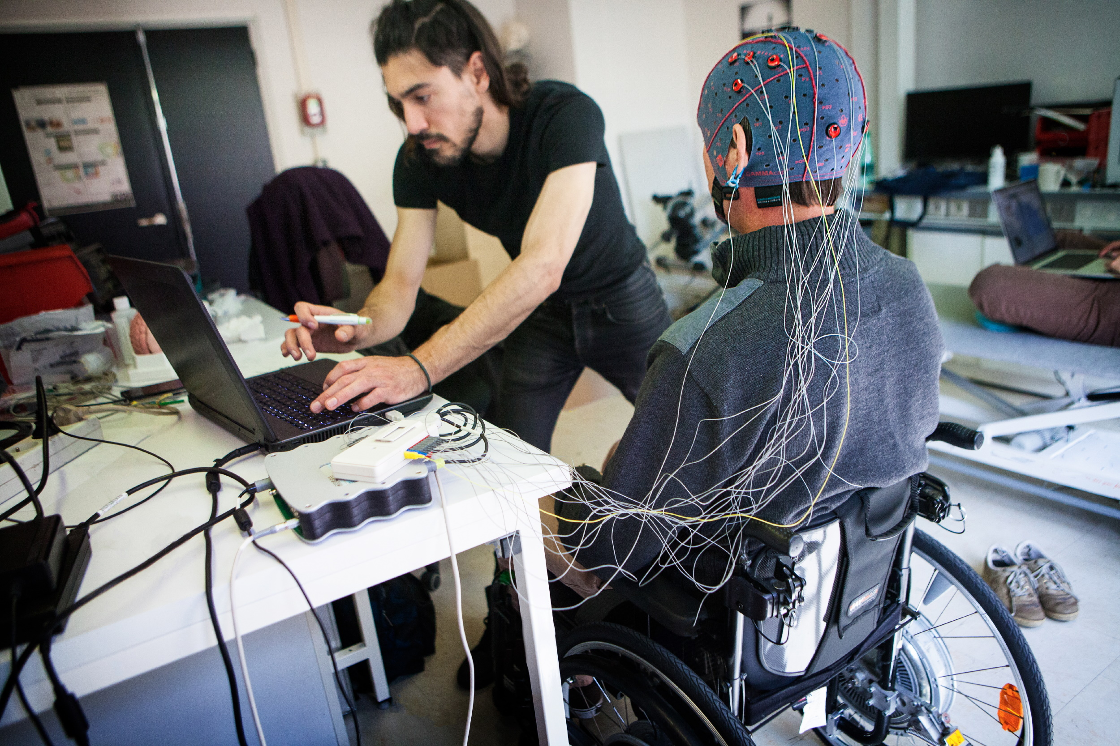
Non-Invasive BCIs
- Non-invasive BCIs use external devices like EEG caps to monitor brain activity. They are easier to use and less invasive, but their precision can be limited.

Slide 4
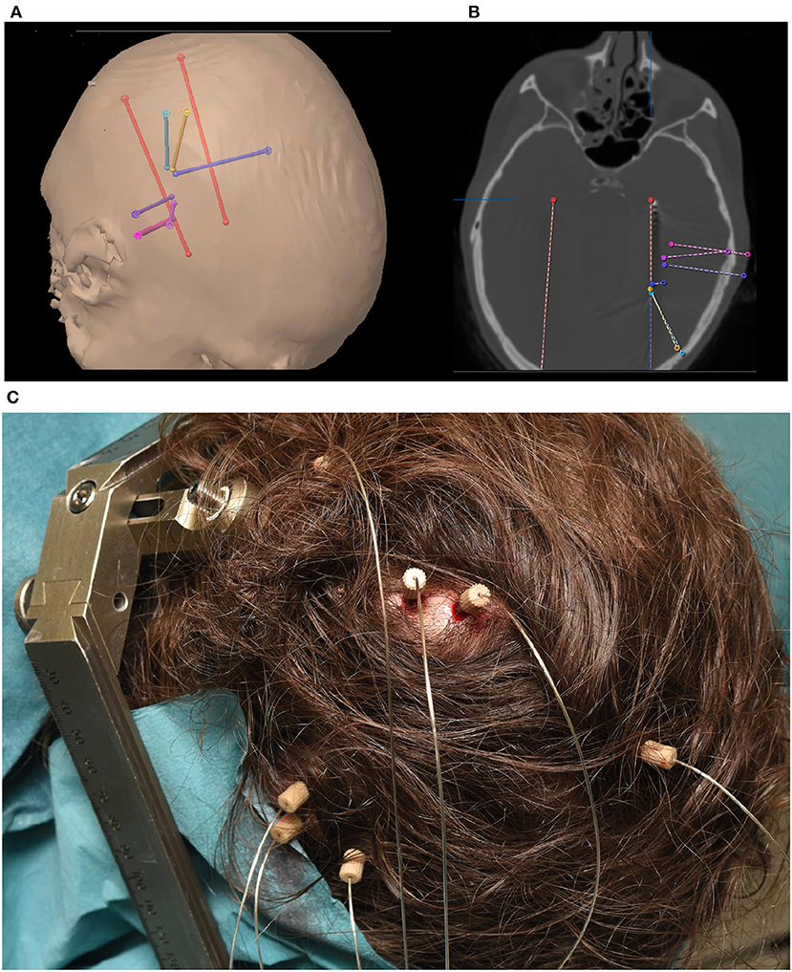
Invasive BCIs
- Invasive BCIs involve implanting electrodes directly into the brain. They provide more accurate readings but come with medical risks and are more complex to implement.

Slide 5
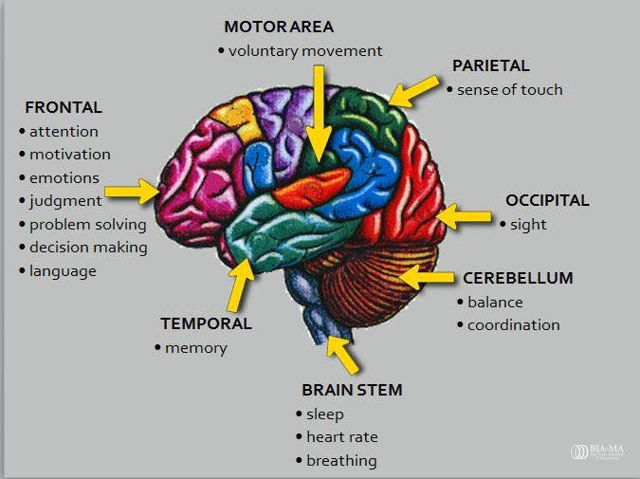
Neuroplasticity and Learning
- Neuroplasticity, the brain's ability to reorganize itself, is crucial for learning to control a prosthetic. Over time, the brain adapts, improving the user's ability to control the device more naturally.

Slide 6
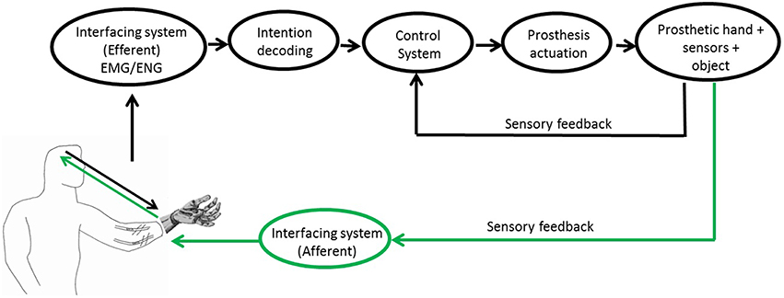
Signal Processing and Decoding
- Neural decoding algorithms interpret brain signals and translate them into commands for the prosthetic. Machine learning techniques are used to improve the decoding process, making the prosthetic more responsive.

Slide 7
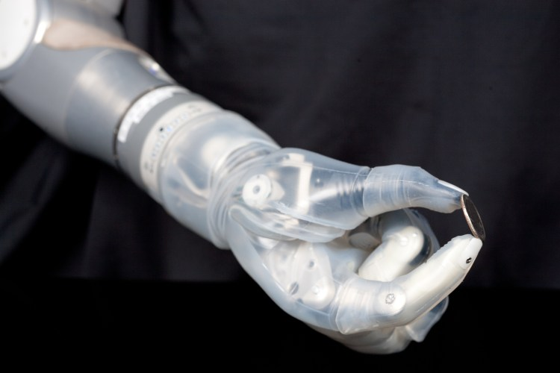
Advanced Robotic Mechanics
- Modern prosthetic hands have multiple joints, allowing for complex movements like finger manipulation, wrist rotation, and even delicate actions. Modular design allows for customization for specific needs, like holding a fork or pen.

Slide 8
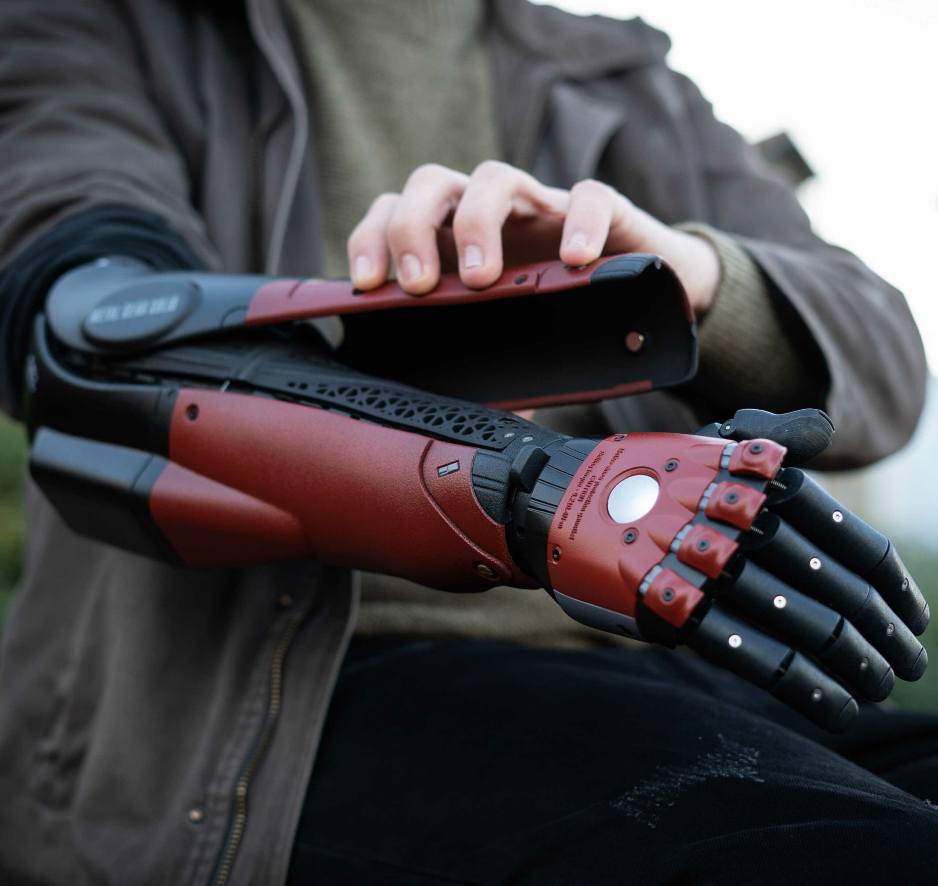
Durable and Lightweight Materials
- Prosthetics are made from lightweight materials like carbon fiber and titanium to reduce fatigue and improve comfort. Rechargeable batteries power the prosthetic, with ongoing innovations to extend battery life.

Slide 9
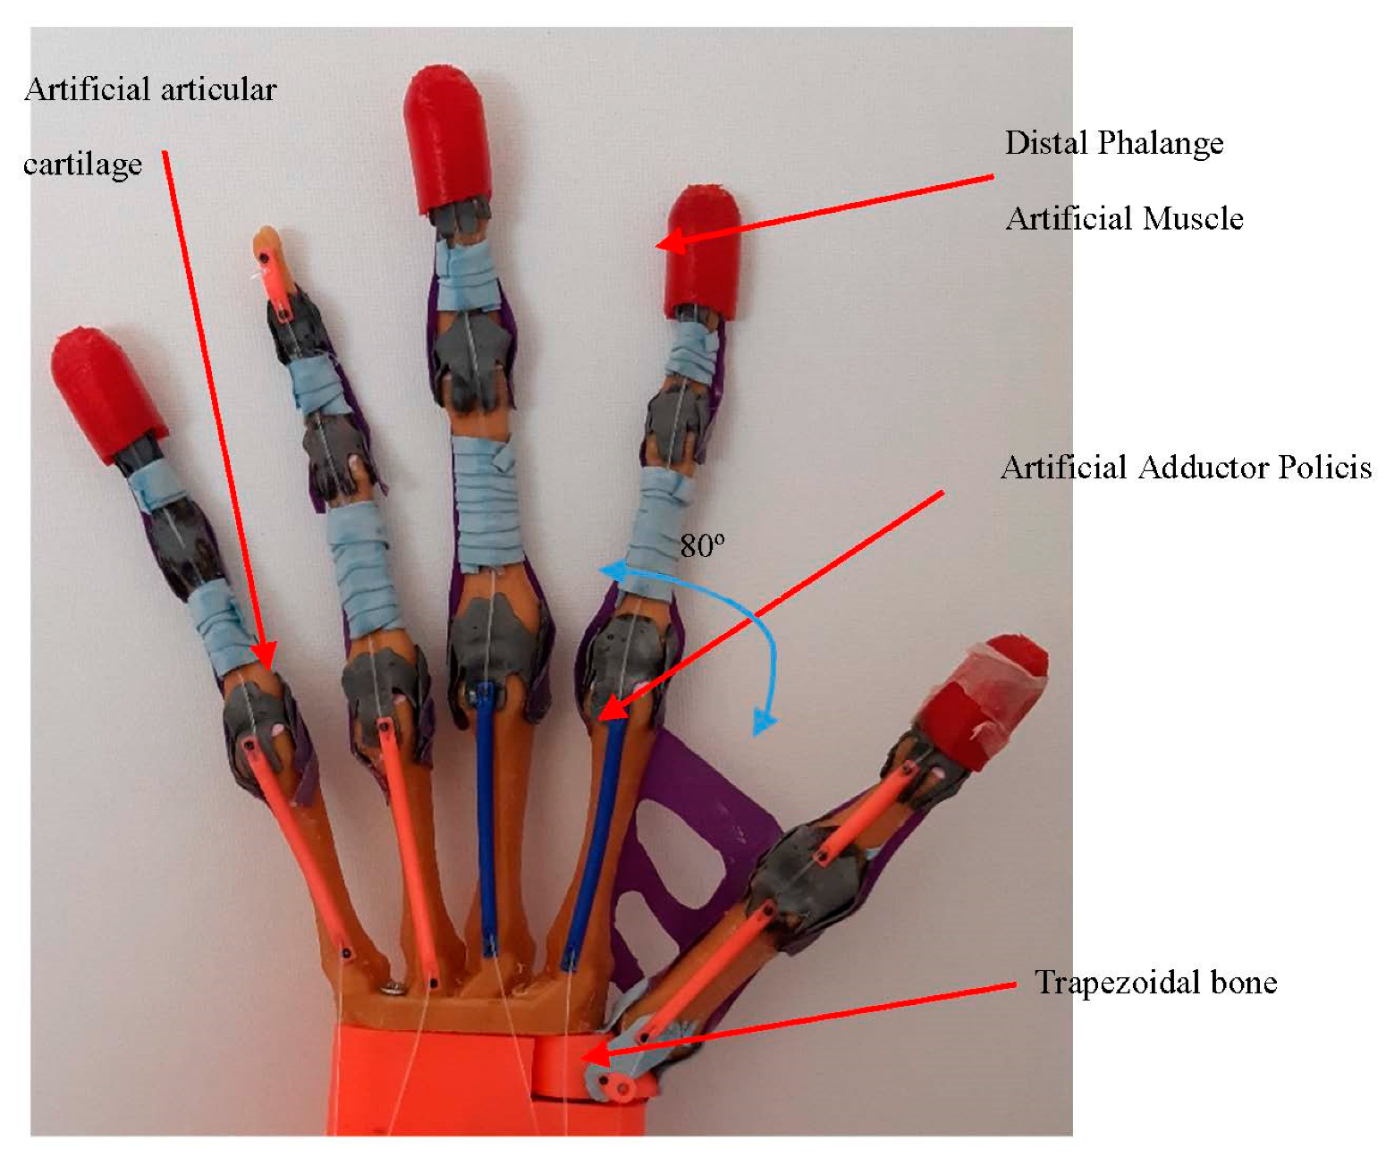
Haptic Feedback: Enhancing Sensory Experience
- Haptic feedback systems provide tactile feedback to the user, allowing them to "feel" through their prosthetic. This sensation is generated through pressure sensors that mimic a sense of touch.

Slide 10
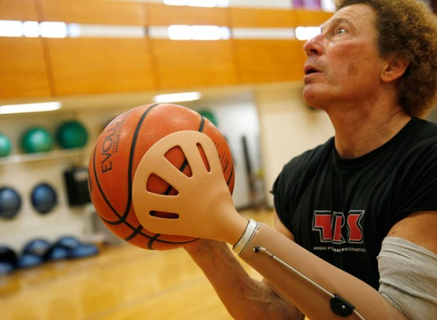
Current Applications and Real-World Use
- Mind-controlled prosthetics are used by veterans, soldiers, and individuals who have lost limbs due to injury or illness. They are also used in medical rehabilitation to help patients regain function and independence.

Slide 11
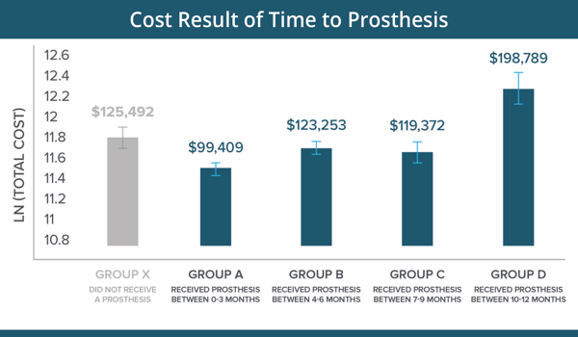
Current Limitations and Research Areas
- High cost is a barrier to access for many potential users. Inconsistent signal accuracy due to factors like fatigue or stress can affect prosthetic performance. Research is ongoing to integrate prosthetics with a broader range of neural networks for more complex movements.

Slide 12
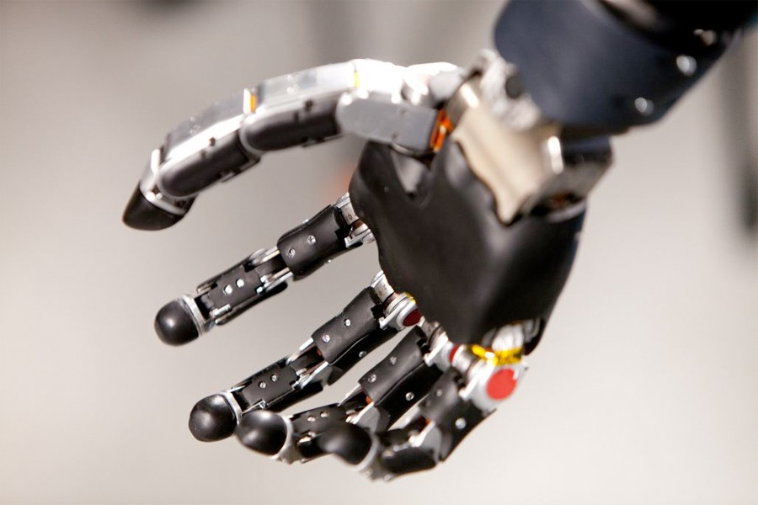
Emerging Innovations and Future Trends
- Researchers are working on fully integrating prosthetics into the nervous system for seamless control and sensory feedback. The goal is to provide users with more immersive sensory feedback, including texture recognition and temperature sensation. Wearable and wireless BCIs are being developed to make the technology less cumbersome. AI-powered adaptive learning will optimize prosthetic responses in real time.

Slide 13
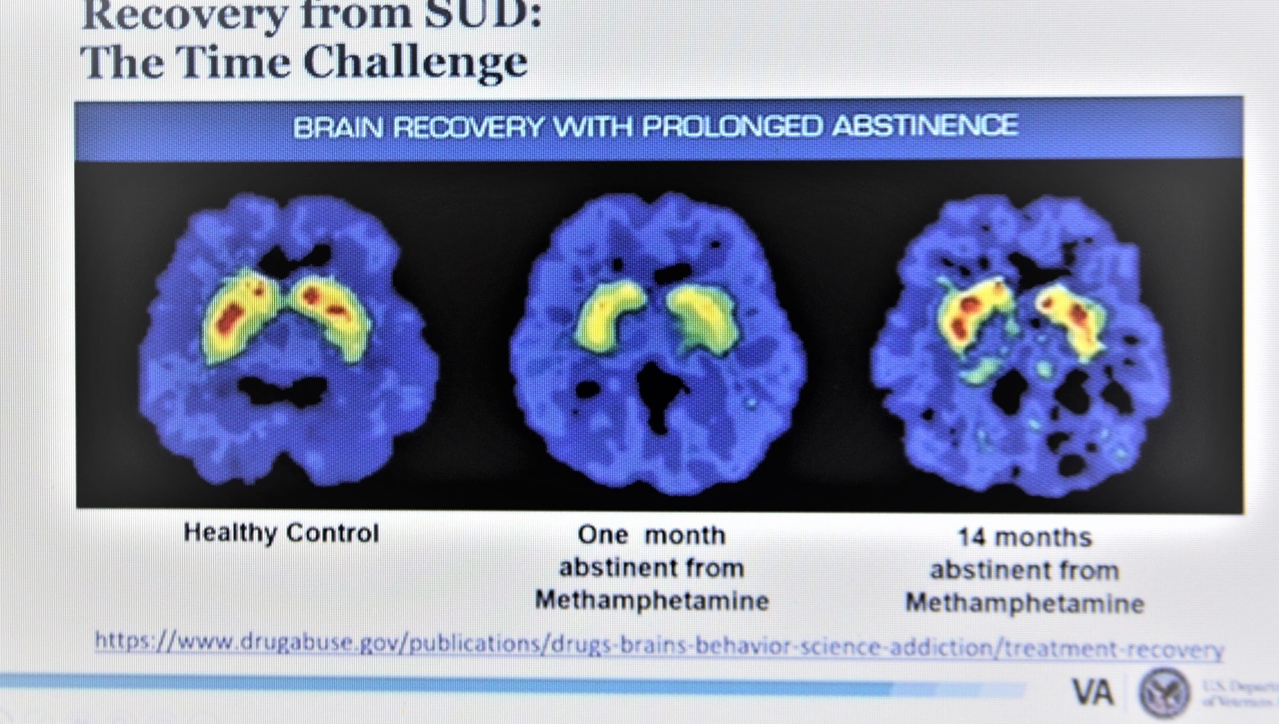
Ethical and Social Considerations
- Privacy concerns arise regarding the collection and use of brain data. Ensuring equitable access to mind-controlled prosthetics across socioeconomic groups is crucial. Ethical considerations surrounding the potential for human enhancement using neuroprosthetics need to be addressed.

Slide 14
Conclusion
- Mind-controlled prosthetic hands are a remarkable advancement in medical technology, offering new possibilities for amputees. Continued innovation in BCIs, robotics, and AI will further refine these systems, creating more natural and seamless experiences for users. As research and development progress, the cost and accessibility of these advanced prosthetics are expected to improve, broadening their impact on society.

